Slide 1
Introduction to Computer Graphics with WebGL
Ed Angel
Professor Emeritus of Computer Science
Founding Director, Arts, Research, Technology and Science Laboratory
University of New Mexico
Angel and Shreiner: Interactive Computer Graphics 7E © Addison-Wesley 2015

Slide 2
Compositing and Blending
Ed Angel
Professor Emeritus of Computer Science
University of New Mexico
Angel and Shreiner: Interactive Computer Graphics 7E © Addison-Wesley 2015

Slide 3
Objectives
Learn to use the A component in RGBA color for
  Blending for translucent surfaces
  Compositing images
  Antialiasing
Angel and Shreiner: Interactive Computer Graphics 7E © Addison-Wesley 2015

Slide 4

Opacity and Transparency
Opaque surfaces permit no light to pass through
Transparent surfaces permit all light to pass
Translucent surfaces pass some light
translucency = 1 – opacity (α)
opaque surface α =1
Angel and Shreiner: Interactive Computer Graphics 7E © Addison-Wesley 2015

Slide 5
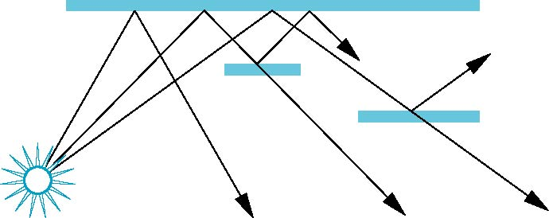
Physical Models
Dealing with translucency in a physically correct manner is difficult due to
  the complexity of the internal interactions of light and matter
  Using a pipeline renderer
Angel and Shreiner: Interactive Computer Graphics 7E © Addison-Wesley 2015

Slide 6
Writing Model
Use A component of RGBA (or RGBα) color to store opacity
During rendering we can expand our writing model to use RGBA values
blend
source blending factor
source
component
destination
component
destination blending
factor
Color Buffer
Angel and Shreiner: Interactive Computer Graphics 7E © Addison-Wesley 2015

Slide 7
Blending Equation
We can define source and destination blending factors for each RGBA component
s = [s_{r}, s_{g}, s_{b}, s_{α}]
d = [d_{r}, d_{g}, d_{b}, d_{α}]
Suppose that the source and destination colors are
b = [b_{r}, b_{g}, b_{b}, b_{α}]
c = [c_{r}, c_{g}, c_{b}, c_{α}]
Blend as
c’ = [b_{r} s_{r}+ c_{r} d_{r}, b_{g} s_{g}+ c_{g} d_{g} , b_{b} s_{b}+ c_{b} d_{b} , b_{α} s_{α}+ c_{α} d_{α} ]
Angel and Shreiner: Interactive Computer Graphics 7E © Addison-Wesley 2015

Slide 8
OpenGL Blending and Compositing
Must enable blending and pick source and destination factors
gl.enable(gl.BLEND)
gl.blendFunc(source_factor,
destination_factor)
Only certain factors supported
  gl.ZERO, gl.ONE
  gl.SRC_ALPHA, gl.ONE_MINUS_SRC_ALPHA
  gl.DST_ALPHA, gl.ONE_MINUS_DST_ALPHA
  See Redbook for complete list
Angel and Shreiner: Interactive Computer Graphics 7E © Addison-Wesley 2015

Slide 9
Example
Suppose that we start with the opaque background color (R₀,G₀,B₀,1)
  This color becomes the initial destination color
We now want to blend in a translucent polygon with color (R₁,G₁,B₁,α₁)
Select GL_SRC_ALPHA and GL_ONE_MINUS_SRC_ALPHA as the source and destination blending factors
R’₁ = α₁ R₁ +(1- α₁) R_{0,} ……
Note this formula is correct if polygon is either opaque or transparent
Angel and Shreiner: Interactive Computer Graphics 7E © Addison-Wesley 2015

Slide 10
Clamping and Accuracy
All the components (RGBA) are clamped and stay in the range (0,1)
However, in a typical system, RGBA values are only stored to 8 bits
  Can easily loose accuracy if we add many components together
  Example: add together n images
    Divide all color components by n to avoid clamping
    Blend with source factor = 1, destination factor = 1
    But division by n loses bits
Angel and Shreiner: Interactive Computer Graphics 7E © Addison-Wesley 2015

Slide 11
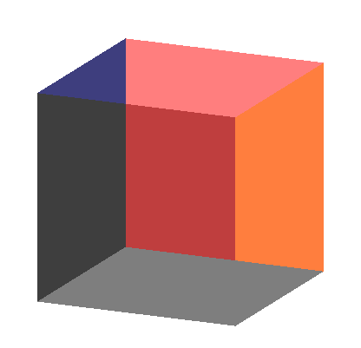
Order Dependency
Is this image correct?
  Probably not
  Polygons are rendered
  in the order they pass
  down the pipeline
  Blending functions
  are order dependent
Angel and Shreiner: Interactive Computer Graphics 7E © Addison-Wesley 2015

Slide 12
Opaque and Translucent Polygons
Suppose that we have a group of polygons some of which are opaque and some translucent
How do we use hidden-surface removal?
Opaque polygons block all polygons behind them and affect the depth buffer
Translucent polygons should not affect depth buffer
  Render with gl.depthMask(false) which makes depth buffer read-only
Sort polygons first to remove order dependency
Angel and Shreiner: Interactive Computer Graphics 7E © Addison-Wesley 2015

Slide 13
Fog
We can composite with a fixed color and have the blending factors depend on depth
  Simulates a fog effect
Blend source color C_{s} and fog color C_{f} by
C_{s}’=f C_{s} + (1-f) C_{f}
f is the fog factor
  Exponential
  Gaussian
  Linear (depth cueing)
Deprecated but can recreate
Angel and Shreiner: Interactive Computer Graphics 7E © Addison-Wesley 2015

Slide 14
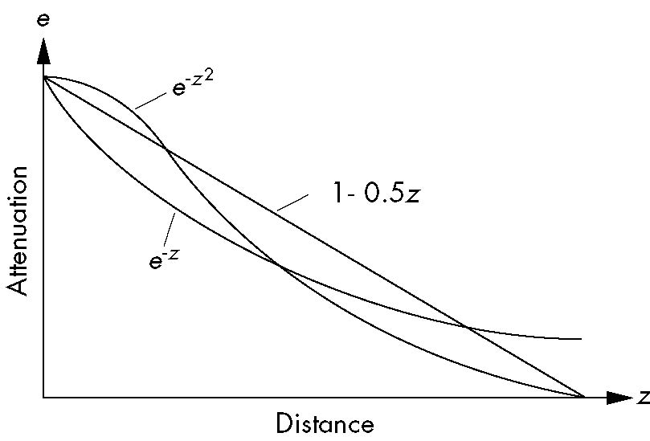
Fog Functions
Angel and Shreiner: Interactive Computer Graphics 7E © Addison-Wesley 2015

Slide 15
Compositing and HTML
In desktop OpenGL, the A component has no effect unless blending is enabled
In WebGL, an A other than 1.0 has an effect because WebGL works with the HTML5 Canvas element
A = 0.5 will cut the RGB values by ½ when the pixel is displayed
Allows other applications to be blended into the canvas along with the graphics
Angel and Shreiner: Interactive Computer Graphics 7E © Addison-Wesley 2015

Slide 16
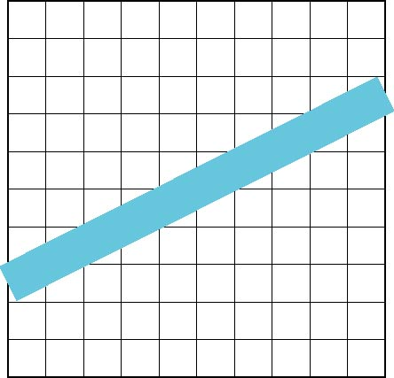
Line Aliasing
Ideal raster line is one pixel wide
All line segments, other than vertical and horizontal segments, partially cover pixels
Simple algorithms color
only whole pixels
Lead to the “jaggies”
or aliasing
Similar issue for polygons
Angel and Shreiner: Interactive Computer Graphics 7E © Addison-Wesley 2015

Slide 17
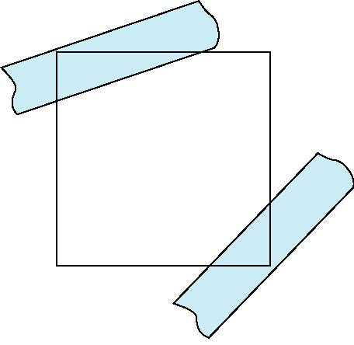
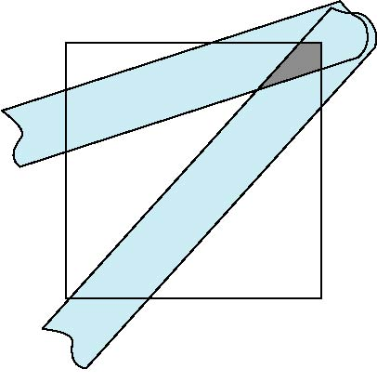
Antialiasing
Can try to color a pixel by adding a fraction of its color to the frame buffer
  Fraction depends on percentage of pixel covered by fragment
  Fraction depends on whether there is overlap
no overlap
overlap
Angel and Shreiner: Interactive Computer Graphics 7E © Addison-Wesley 2015

Slide 18
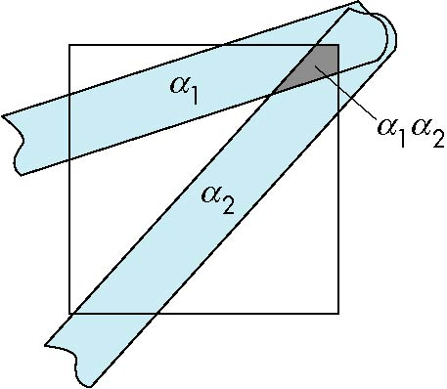
Area Averaging
Use average area α₁+α₂-α₁α₂ as blending factor
Angel and Shreiner: Interactive Computer Graphics 7E © Addison-Wesley 2015

Slide 19
OpenGL Antialiasing
Not (yet) supported in WebGL
Can enable separately for points, lines, or polygons
Note most hardware will automatically antialias
glEnable(GL_POINT_SMOOTH);
glEnable(GL_LINE_SMOOTH);
glEnable(GL_POLYGON_SMOOTH);
glEnable(GL_BLEND);
glBlendFunc(GL_SRC_ALPHA, GL_ONE_MINUS_SRC_ALPHA);
Angel and Shreiner: Interactive Computer Graphics 7E © Addison-Wesley 2015

